Slide 1


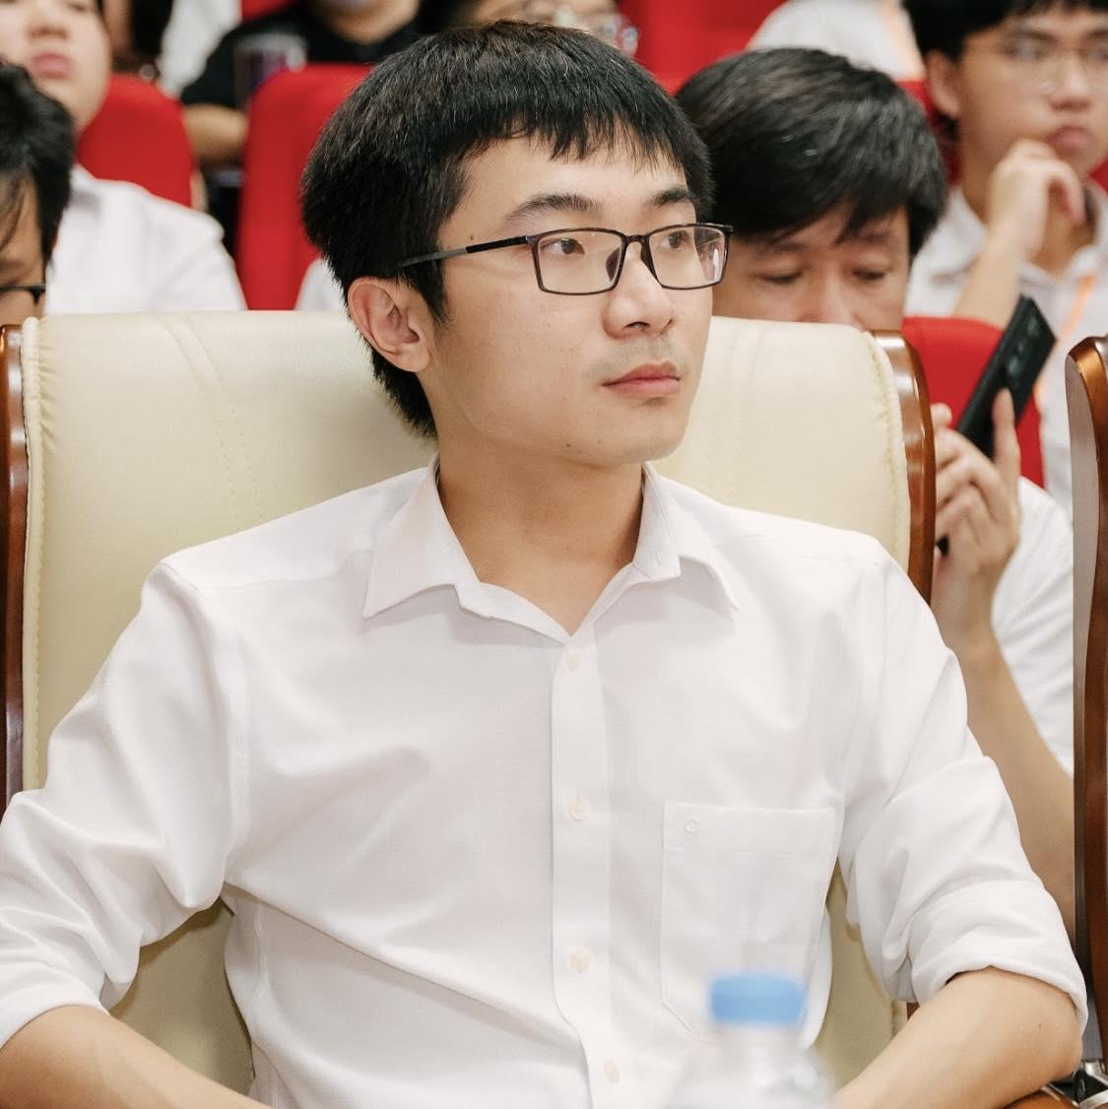
fullstackdatascience.com
Exploring SQL
to combine data
When asked for advice for data scientists, the father of Python responded, "Learn SQL."
Created by HuyNT
DA K6
Lesson 2
huynt@fullstackdatascience.com
1

Slide 2

Learn
About
01/
Join (Left, Right, Inner, Full, Self)
02/
Union - Union All
03/
Bigquery Practice
fullstackdatascience.com
2

Slide 3
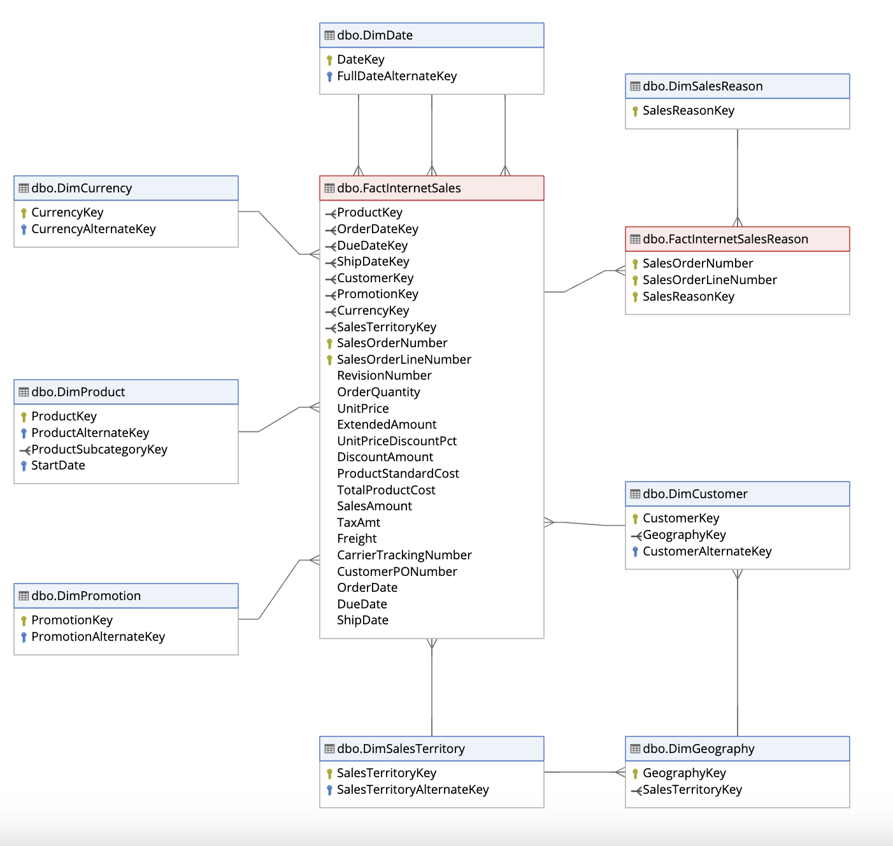
Retrospective
Data Dictionary
https://dataedo.com/samples/html/Data_warehouse/doc/AdventureWorksDW_4/home.html
3

Slide 4
JOIN
Inner Join
Left Join
Right Join
Full Join
Self Join
3

Slide 5
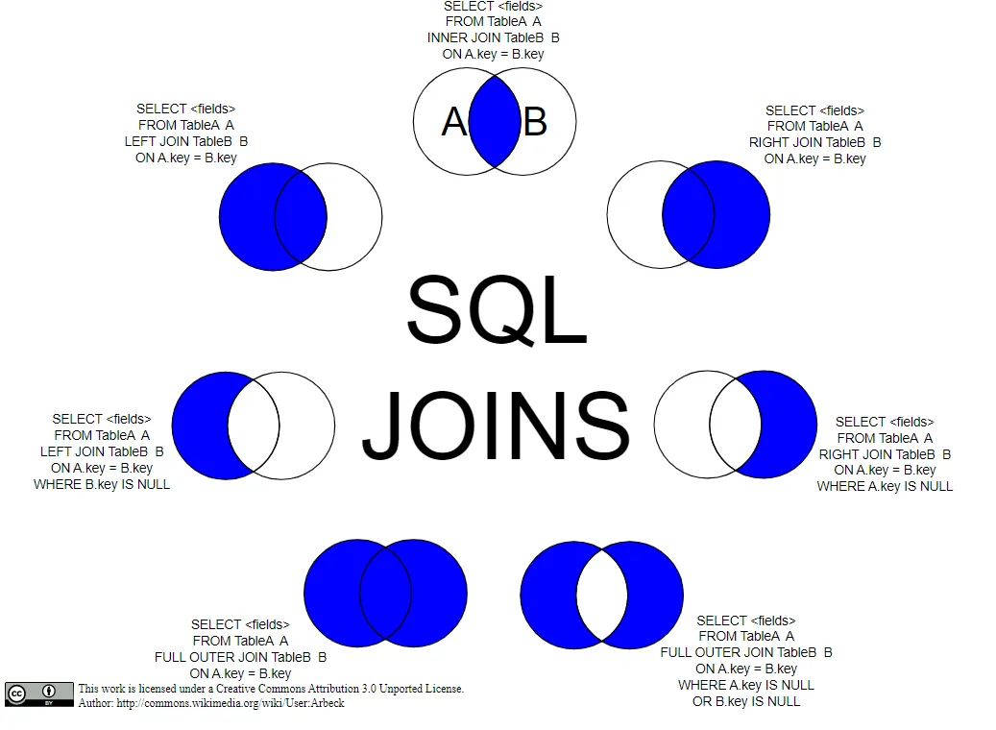
JOIN Clause
Purpose: combines rows from two or more table based on a specified set of conditions
5

Slide 6
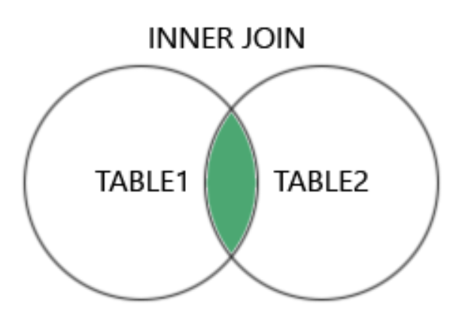
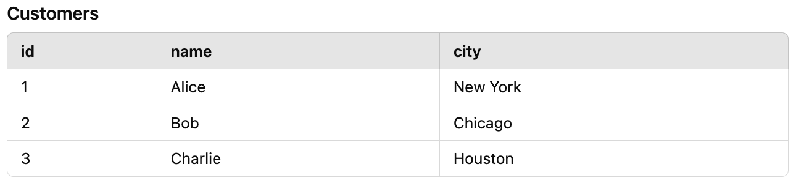
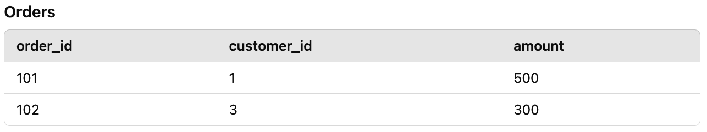
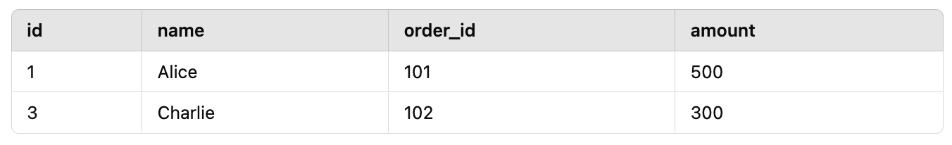
Inner Join
Returns only matching records from both tables.
+
SELECT Customers.id, Customers.name, Orders.order_id, Orders.amount
FROM Customers
INNER JOIN Orders ON Customers.id = Orders.customer_id;
5

Slide 7
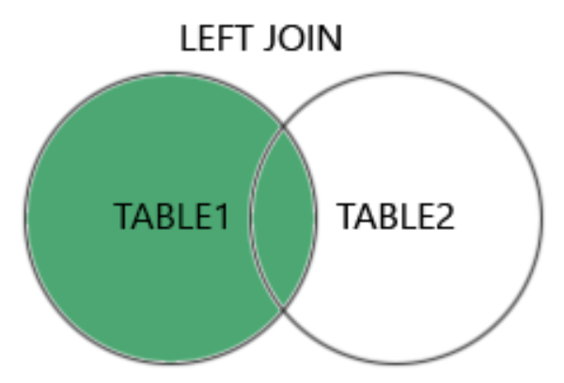
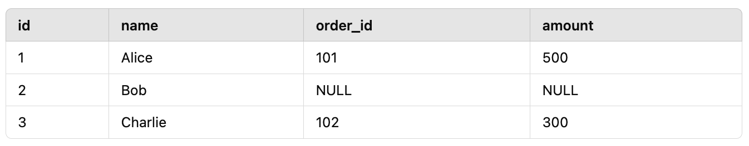
Left Join
Returns all records from the left table, plus matching records from the right table.
If no match, NULL is returned for the right table.
+
SELECT Customers.id, Customers.name, Orders.order_id, Orders.amount
FROM Customers
LEFT JOIN Orders ON Customers.id = Orders.customer_id;
5

Slide 8
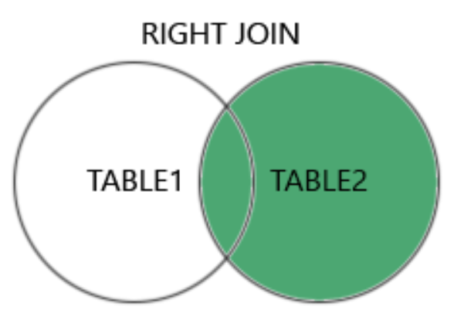
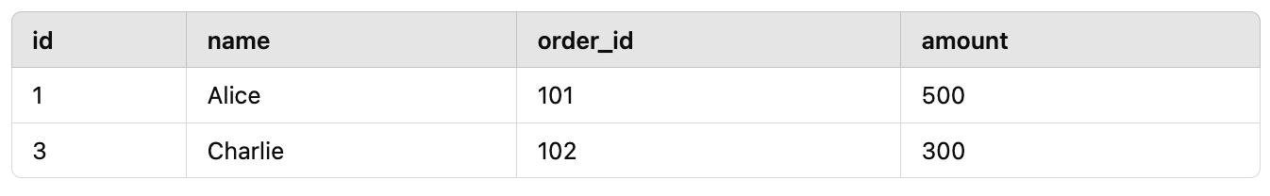
Right Join
Returns all records from the right table, plus matching records from the left table.
If no match, NULL is returned for the left table.
+
SELECT Customers.id, Customers.name, Orders.order_id, Orders.amount
FROM Customers
RIGHT JOIN Orders ON Customers.id = Orders.customer_id;
5

Slide 9
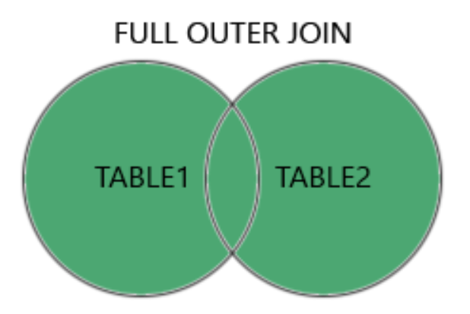
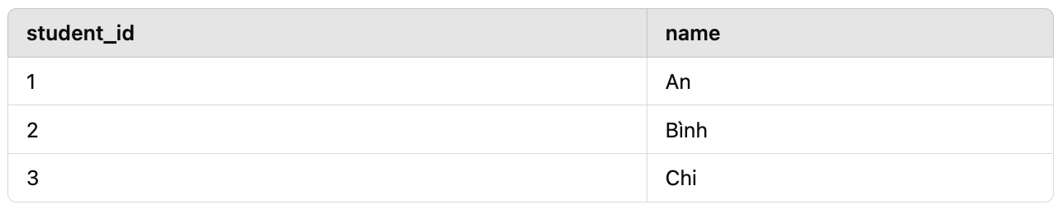
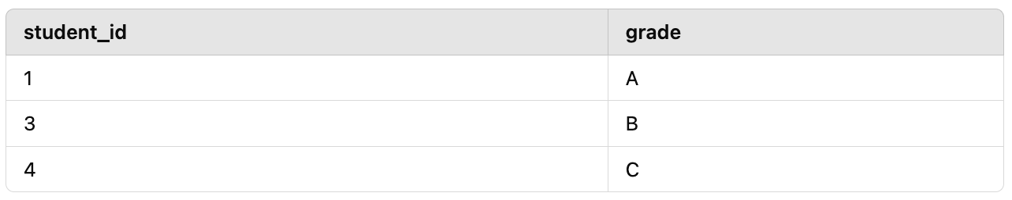
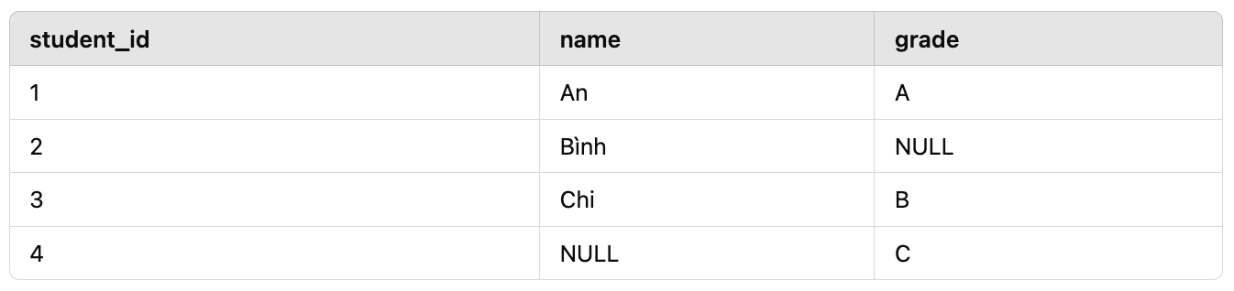
Full Outer Join
Returns all records when there is a match in either table.
NULL is returned where there is no match.
+
SELECT Students.student_id, Students.name, Grades.grade
FROM Students
FULL OUTER JOIN Grades ON Students.student_id = Grades.student_id;

Slide 10
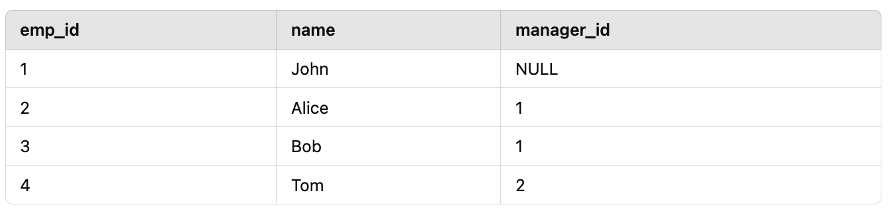
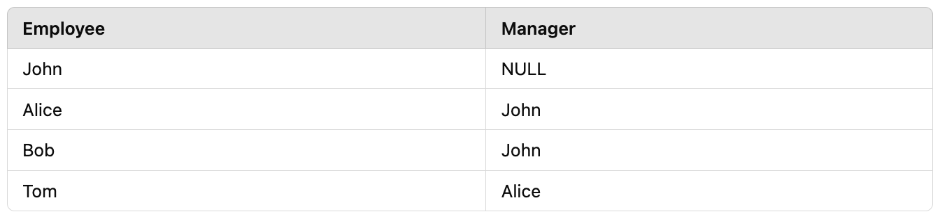
Self Join
Joins a table with itself.
SELECT e1.name AS Employee, e2.name AS Manager
FROM Employees e1
LEFT JOIN Employees e2 ON e1.manager_id = e2.emp_id;

Slide 11
Excersice
From FactInternetSales and DimSalesTerritory, Write a query displaying the sales orders where the sales amount exceeds $1,000.
From DimProduct and DimProductSubcategory, Write a query displaying the Product key, EnglishProductName, and Color columns which has EnglishProductSubCategoryName is 'Mountain Bikes'.
Hãy sử dụng bảng FactInternetSales và bảng DimProduct, để lấy ra những đơn hàng của những sản phẩm có màu Đen.
Hãy sử dụng bảng FactInternetSales và bảng DimCustomer, để lấy ra đơn hàng những người có title là Mr.
Hãy sử dụng bảng FactInternetSales, bảng DimProduct và DimCustomer, để lấy ra những đơn hàng của những sản phẩm có màu Đen và những đơn đó được đặt bởi những người có title là Mr.
Hãy sử dụng các bảng cần thiết, để lấy ra những đơn hàng (FactInternetsales) của những khách hàng (DimCustomer) sinh sống tại Canada và Australia.
Hãy sử dụng các bảng cần thiết, để tính tổng doanh thu của những đơn hàng (FactInternetsales) của những khách hàng (DimCustomer) sinh sống tại Canada và Australia.
SELECT * FROM table1
JOIN table 2 on table1.X = table2.Y
JOIN table 3 on table1.Z = table3.P
5

Slide 12
Union
Union
Union All
3

Slide 13
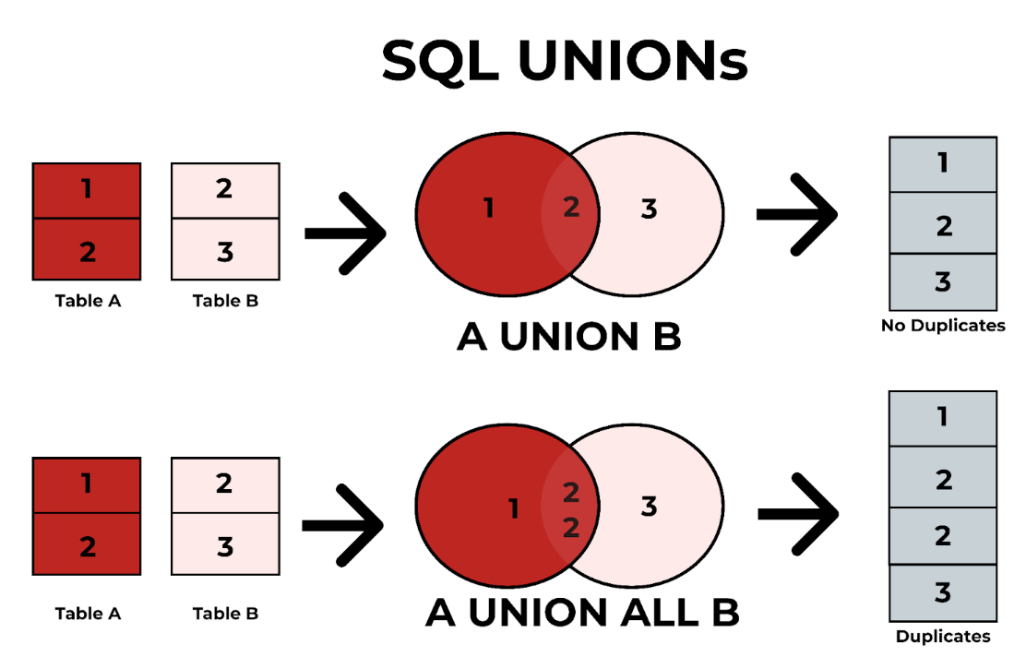
Union - Union All
UNION and UNION ALL are used to combine the results of two or more SELECT statements.
5

Slide 14
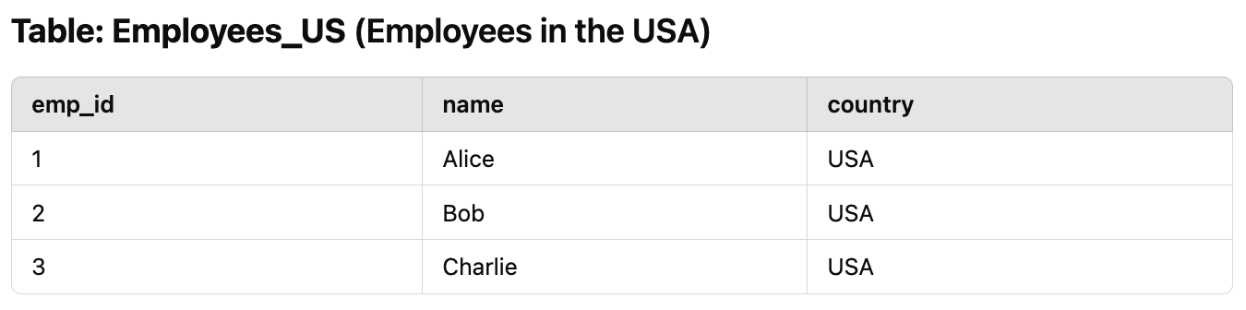
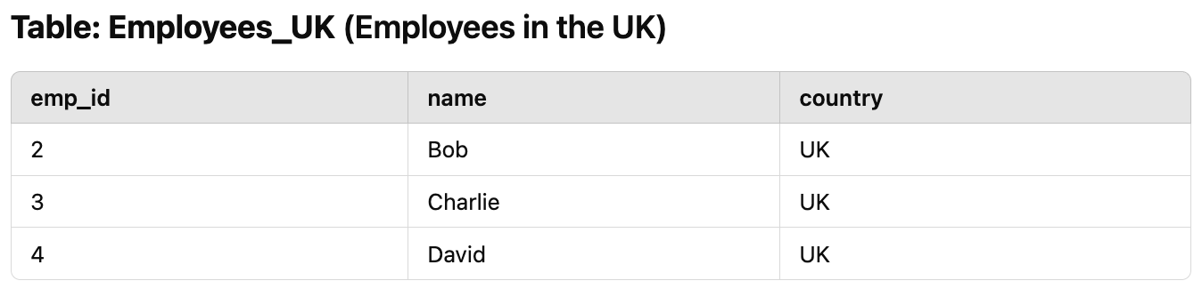
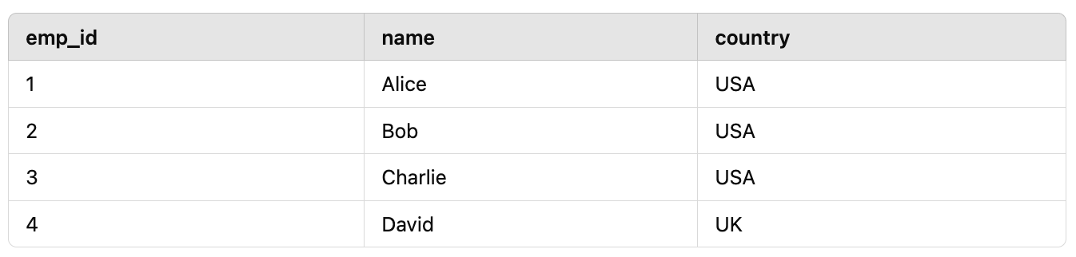
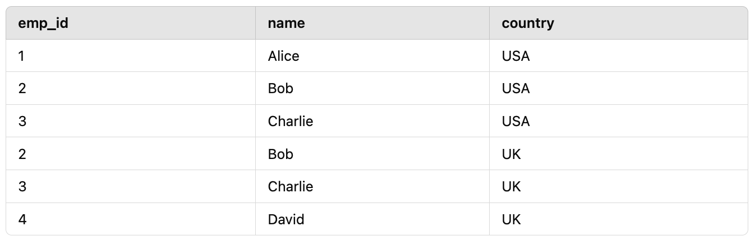
Union - Union All (Example)
+
SELECT emp_id, name, country FROM Employees_US
UNION/UNION DISTINCT
SELECT emp_id, name, country FROM Employees_UK;
SELECT emp_id, name, country FROM Employees_US
UNION ALL
SELECT emp_id, name, country FROM Employees_UK;
5

Slide 15
Working with Bigquery console
Excersice
Practice time
3

Slide 16
Excersice
Exercise 1: List of Customers and Resellers
Retrieve a list of customers from DimCustomer and resellers from DimReseller, with the following columns:
ID (Customer or Reseller ID)
Name (Full name of the customer or reseller)
Type (Categorized as 'Customer' or 'Reseller')
Requirements:
Use UNION DISTINCT to remove duplicate records.
Exercise 2: Revenue from Internet and Reseller Sales
Retrieve sales data from FactInternetSales and FactResellerSales, with the following columns:
SalesOrderNumber (Order number)
SalesAmount (Total revenue)
Source (Categorized as 'Internet' or 'Reseller')
Requirements:
Use UNION ALL to include all records, even duplicates.
5

Slide 17

fullstackdatascience.com
References
https://docs.teradata.com/
https://cloud.google.com/bigquery/docs
https://learn.microsoft.com/en-us/azure/azure-sql/?view=azuresql
https://www.postgresql.org/docs/
https://dev.mysql.com/doc/
https://www.youtube.com/watch?v=TvLWozM182E&t=1481s
11

Slide 18





Thank you
096 574 90 25
CREATED BY
Nguyen Tien Huy
info@robusto.ai
fullstackdatascience
huynt@fullstackdatascience.com
Data Manager
https://fullstackdatascience.com/
Hanoi, Vietnam

